Slide 1
Google Data Analytics Capstone Project: Cyclistic
Prepared by: Pavitra Rana
File created on: 09/25/2021
Business task:
Analyze the usage of Cyclistic bikes differently by annual members and casual riders

Slide 2
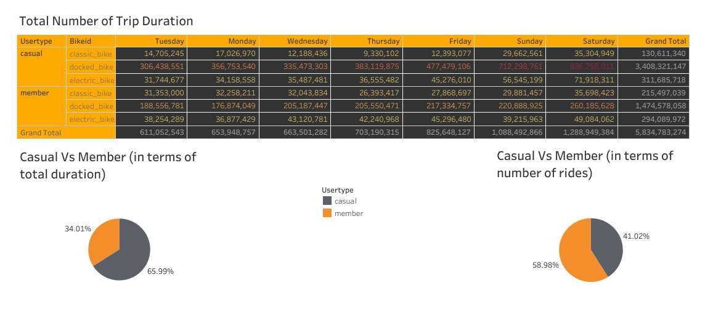
There are two user type casual and member using three types of bikes where total duration of the trip of casual is 65.99 % and member is 34.01%.
The trip duration on Sunday and Saturday are more than among the weekdays.
There is a high number of duration in docked bike in both user type.

Slide 3
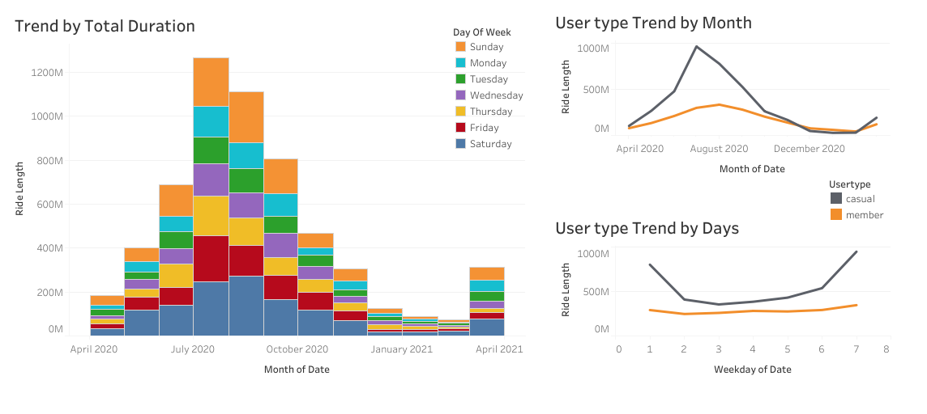
The bar graph shows the total duration of all 12 months with categorizing weekdays in the bars.
There is a high peak of usage of bikes in weekends in the month of august followed by Friday and Thursday.
There is a high peak of usage of casual user type on the basis of months and days.

Slide 4
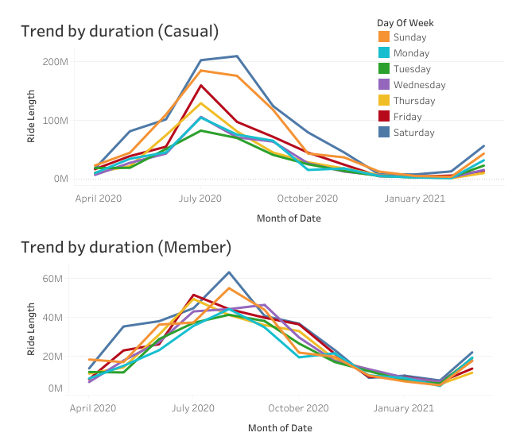
The riders are engaging with a high number of duration in the month of August and lowest in the month of April.
The trip duration on the basis of weekdays, there is a high engagement in the days of Saturday and Sunday, and the lowest engagement in Tuesday.

Slide 5
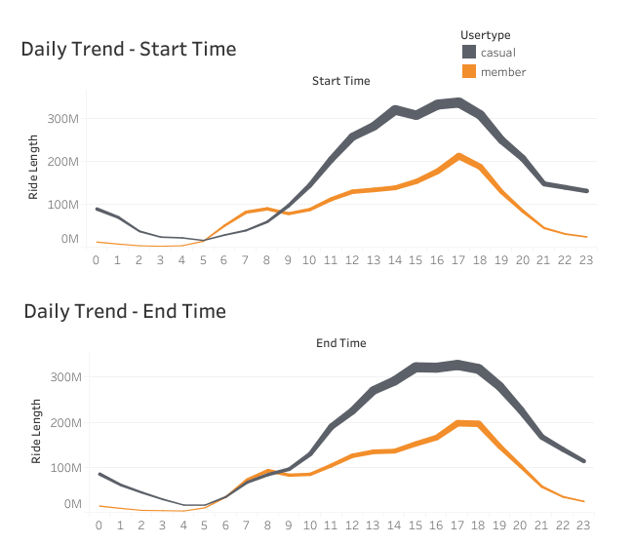
The line graph shows the start time of both user type riders. In terms of time the casual riders are active in the evening at 4PM and 5PM.
The member riders usually active in the morning at 7AM and in the evening at 5pm.

Slide 6
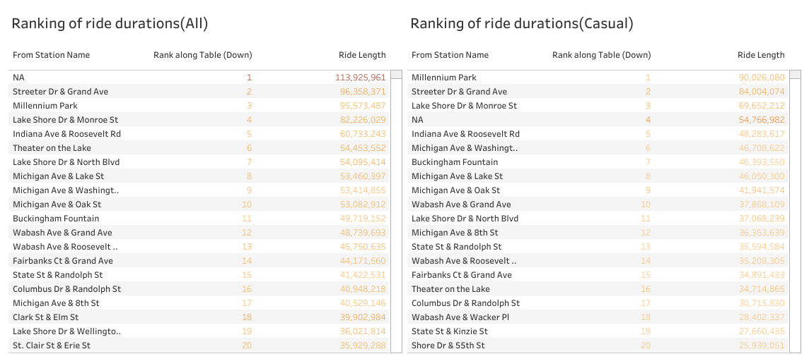
The table shows the top 20 ranking of high durations of rides.
On the basis of ranking and high number of hours duration the majority of the riders are from tourist places.

Slide 7
Summary
The duration of total trip of both user type casual and member are affected according to the month. As the data are given for 12 months and according to the months the seasonal figures depict the higher usage of the bikes in August. Due to different seasons, the duration is affected because during the winter season the temperature is very low, so fewer people willing to use the bikes or travel instead they are using public transport. This leads to a low number of users in the winter season among other seasons of trip duration.
The riders of members use to ride at 7 AM morning that indicates that the riders are likely the office users who use bikes to ride to reach their office and at 5 pm evening, it indicates they use the rides to back to their home.
The riders of casual use to ride in the evening with different times mostly at 4 PM and 5 PM evening that indicate that the riders are likely the locals and tourist who use to ride daily or according to their daily activities, the casual users most likely are the students, local people, family, tourists, etc.

Slide 8
Recommendations
According to the behavior of users of the casual riders based on the month the suitable time to pitch a marketing strategy or marketing campaign is between April to May.
Additionally for an effective marketing campaign, consider different strategies such as discount coupons, seasonal coupons, and free rides to increase the conversion rate.
For a more effective marketing strategy, the marketing team can collect more data about the types of users of casual riders. So that the strategy is designed and planned effectively for the targeted user. Therefore, the team could run a survey & questionnaire to collect the relevant information that leads to help in pitching different strategies effectively and efficiently such as their interests, likes & dislikes, and what they are looking for, considering applying for an annual subscription.

